Slide 1
Adoption Grant How-to Guide
OHID MFA, ID Proofing, & DocV
February 2025
Notes:
You have a white and blue option for your title slide

Slide 2
Agenda
1
Introduction
2
User Journey 1: Existing OHID User, Existing Adoption Grant User: ID Proofing with DocV
3
User Journey 2: Existing OHID User, New Adoption Grant User: ID Proofing with DocV
4
User Journey 3: New OHID User, New Adoption Grant User: ID Proofing with DocV
5
User Journey 4: Adoption Grant and OHID: OHID Profile Updates
6
Frequently Asked Questions
Notes:
You have 2 agenda slide options you can customize to meet your needs based on the areas you need to cover

Slide 3
Introduction
Notes:
Each section should have a transition slide

Slide 4
What’s Changing?
Transition
The Department of Children & Youth is adding Multi-factor Authentication (MFA), ID Proofing Enhancements, and Document Verification (DocV) to the Adoption Grant application. These new features are all about making your online interactions more secure and protecting your personal information.
Enrollment & Go Live
The new application will be going live on February 13, 2025, and the project team will be providing 2 weeks of hypercare support.
What This Means For You
As a help desk team who comes into contact with Adoption Grant application users, you may encounter user questions related to the Adoption Grant transition process.
This job aid aims to provide you with a guide to common scenarios and answers to frequently asked questions.

Slide 5






MFA Enrollment
MFA provides additional security to verify a customer’s identity when they access agency applications.
After creating an OHID account, customers will be required to set up MFA through Account Settings. Existing users will be prompted to do the same as well.
During set up, customers will need to select two verification methods.
SMS Text Message
Email
Phone Call
An SMS text with a PIN will be sent to the user’s phone number.
A PIN will be sent to the user’s email.
An automated call will be made to the user’s phone number.
Please note that if customers choose SMS text and phone call, they will need two different phone numbers.
Fido Device
Authenticator App
IBM Verify App
User is given the option to purchase and register an authenticator to enable passwordless authentication.
User is given the option to verify with a one-time access code that is generated by an authenticator app on a mobile phone or tablet.
User is given the option to authenticate through PIN displayed in app and an in-app push button option.
Indicates Recommended

Slide 6
Why MFA?
This winter, the Ohio Adoption Grant Program (OAGP) will integrate the Adoption Grant application with a trusted digital identity platform. This integration will enhance the OHID single sign-on (SSO) process through the addition of Multi-Factor authentication (MFA), allowing simpler, safer application access for external users to protect both citizens and the State.
1
The InnovateOhio Platform (IOP) is the State’s trusted digital identity platform
FREQUENTLY ASKED QUESTIONS
Q: Why is OAGP integrating with MFA?
A: The combination of OHID SSO and MFA help provide simpler, safer sign-on for OAGP users by streamlining their login process to one unique set of credentials and authenticating their identities. This helps keep citizen information secure.
Q: How should this transition be communicated to citizens using our application?
A: We will begin sharing resources that include communications, job aids and support resources to alert citizens to the transition timeline, required actions, and to encourage proactive enrollment.
Q: What support resources will be available to OAGP and citizens?
A: We will provide internal communications to OAGP, including training and job aids to key help desk personnel, as well as communications, job aids, and support resources for citizen users.
OHID Single Sign On (SSO) refers to a single set of unique log in credentials (OHID and Password)
Multi-Factor Authentication (MFA) is a second form of verification that confirms the user logging in is who they claim to be
2
3
OHID SSO and MFA work together to help keep confidential and sensitive information secure and enable access to State agency applications

Slide 7
What is Identity Proofing?
Identity Proofing is a process of verifying an individual’s identity through personal information to decrease the potential for fraudulent activities and increase security when interacting with state programs.
CHANGE DETAIL
CURRENT USERS*
All Adoption Grant application users will be required to verify their identities through Socure
Lightweight check for every OHID account created, which will:
  Increase accuracy that the user is real
  Improve security for agencies
  Reduce fraud
Identity proofing will be based off multiple risk factors such as:
  Personal information
  Device/Phone
  Address
  Email
Financial information is no longer required. Only the following personal information will be needed to complete new ID Proofing:
  Legal Name
  Date of Birth
  Address
  Social Security Number
  Phone number (optional)
Existing users will log into their OHID accounts. When the user attempts to access their Adoption Grant account, they will be prompted to complete ID Proofing through Socure.
NEW USERS*
An initial identity verification check against the user's email will run during the user creation process. Upon successful account creation, new Adoption Grant users will attempt to navigate to the Adoption Grant application. At this time, the user will be required to complete ID Proofing.
*This process is seamless to the user. The back-end work will send the users' SAML token to the application. Once received by the application, the user will be sent back to Adoption Grant for ID Proofing.
7

Slide 8

What is Document Verification?
How does it work?
DocV uses Optical Character Recognition (OCR) and automated machine learning. The app conducts accurate document verification by proactively guiding the applicant on how to take high-quality photos of both their ID and themselves to validate they are who they say they are.
When is it used?
DocV is always used following the Identity Proofing process through Socure. During the ID Proofing process, there are impact indicators triggered to determine one of the three following ID Proofing scores for an individual: pass, fail, refer. DocV is used as a second source of Identity Proofing to further confirm the results of the scores or catch any reasons that would cause any rejection of Identity authentication.
CHANGE DETAIL
CURRENT USERS
All Adoption Grant application users will be required to verify their identities once again through the DocV process after completing the ID Proofing process through Socure.
Users will need the following to complete DocV:​
  State-issued driver’s license, ID, or passport​
  Access to a smartphone or tablet with a camera​
  Chrome browser for an Android device​
  Safari browser for an iOS device
Existing users will be prompted to complete DocV when they complete the Identity Proofing process through Socure.
NEW USERS
New users will be prompted to complete DocV when they create their new account and complete the ID Proofing process through Socure.
HELP DESKS
Agency help desk agents will need to be prepared to understand the ID Proofing/DocV processes to triage citizen questions.
8

Slide 9
User Journey 1
User Journey 1: Existing OHID User, Existing Adoption Grant User: ID Proofing with DocV
Notes:
Each section should have a transition slide

Slide 10

User Journey 1: Existing OHID User, Existing Adoption Grant User: ID Proofing with DocV
KEY
Adoption Actions
OHID Actions
System Actions
Socure Actions
Redirect
System Access Checkpoint
User
User
System
User
User
Begins process on the DCY Adoption Grant application landing page
User clicks “Launch- Apply for the Ohio Adoption Grant”
Redirects to OHID to login
Logs into OHID Account
User completes MFA registration (if not previously completed) or completes MFA through previously selected option
Pass/Fail/Refer
System
User
Socure Check
User
User
System prompts ID Proofing
User submits Personal/Residential Address Information
User presented with ask to Confirm F/L Name, email address and provide physical address again
Presented screen to access DocV via QR code or SMS code to Phone
ID Proofing: Pass
DocV: Pass
User
User
User
DocV
Socure Check
Scans QR code via mobile device & taken to DocV
Uploads front and back of their ID and uploads a real-time photo of themselves
Reads ID barcode and facial recognition
User
Logs into their account with full access
Any combination of pass/fail or fail/fail between ID Proofing and DocV
User
Reviewer
User logs into Adoption Grant account
Adjudication flag updated in application with result
User passes review
User
Must visit a local office for review
Local Office Check
User
Pass/Fail
Is not granted access to Adoption Grant site
Does not pass review

Slide 11
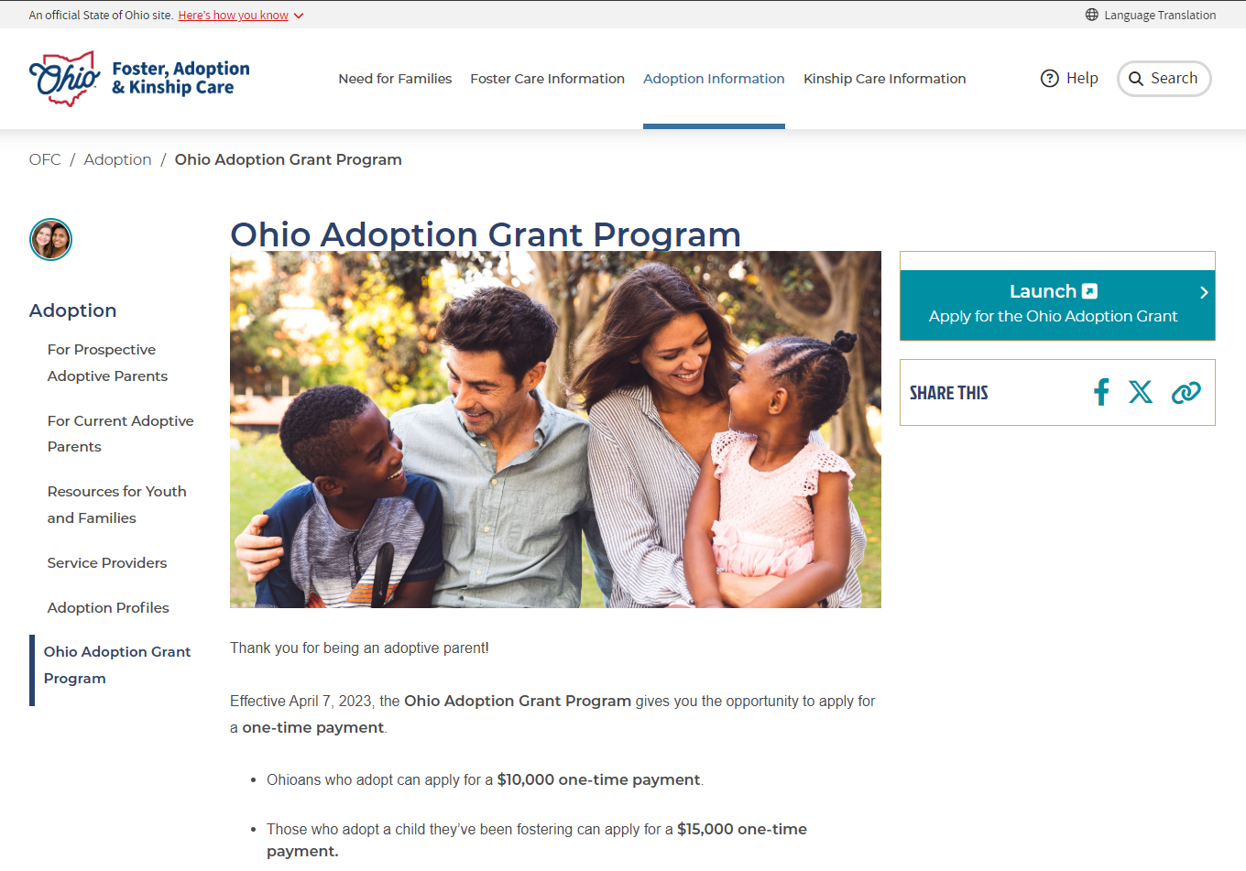
User Journey 1: Existing OHID User, Existing Adoption Grant User: ID Proofing with DocV
1
1. User navigates to the Adoption Grant Application Website:
Navigate to Adoption Grant Application Website at the following URL: Ohio Adoption Grant Program | Foster Care and Adoption in Ohio
Select Launch to Apply for the Ohio Adoption Grant
2
2. User clicks “Launch- Apply for the Ohio Adoption Grant”

Slide 12
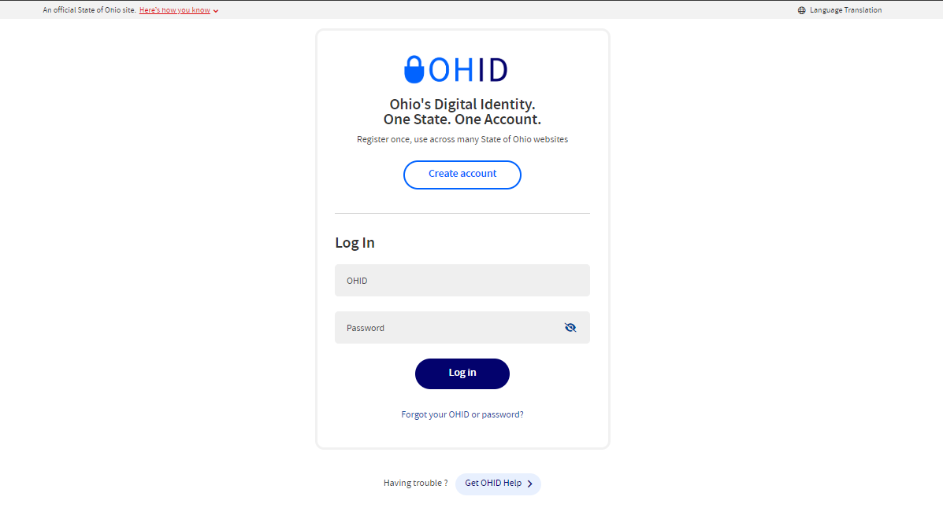
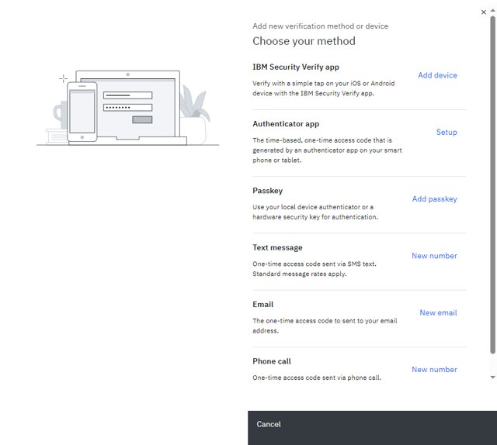
User Journey 1: Existing OHID User, Existing Adoption Grant User: ID Proofing with DocV
3
3. User gets redirected to the OHID login page and logs in with their OHID and password
https://ohid.ohio.gov/wps/portal/gov/ohid/login
4
4. User is prompted to complete MFA registration (if not previously completed) or completes MFA through previously selected option
For additional guidance, please refer to the supplemental guide titled "Adoption Grant MFA & Socure Enhancements Supplemental Guide"

Slide 13
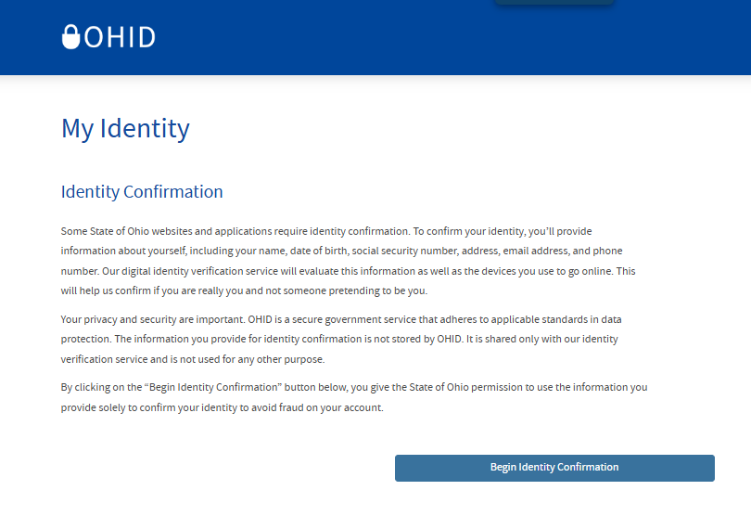
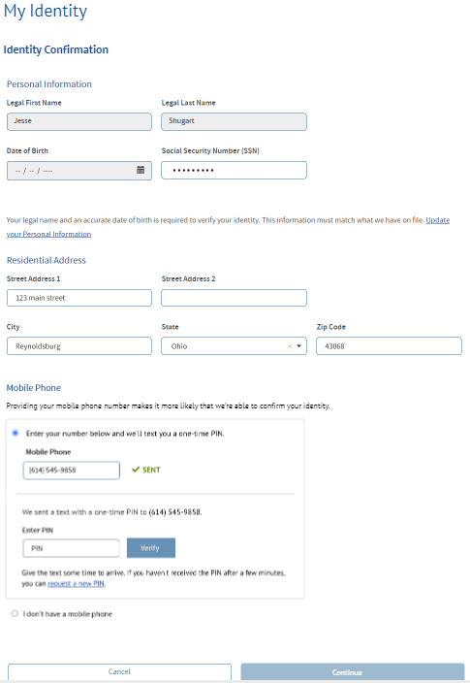
User Journey 1: Existing OHID User, Existing Adoption Grant User: ID Proofing with DocV
5
5. The user will begin the Identity Proofing process
User will be prompted to Identity Proof and will select “Begin Identity Confirmation”
6
6. The user will fill out required Identity information
The user will fill in their personal information, residential address, and mobile phone verification (optional). The user will then select “Submit”

Slide 14
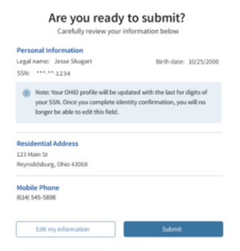
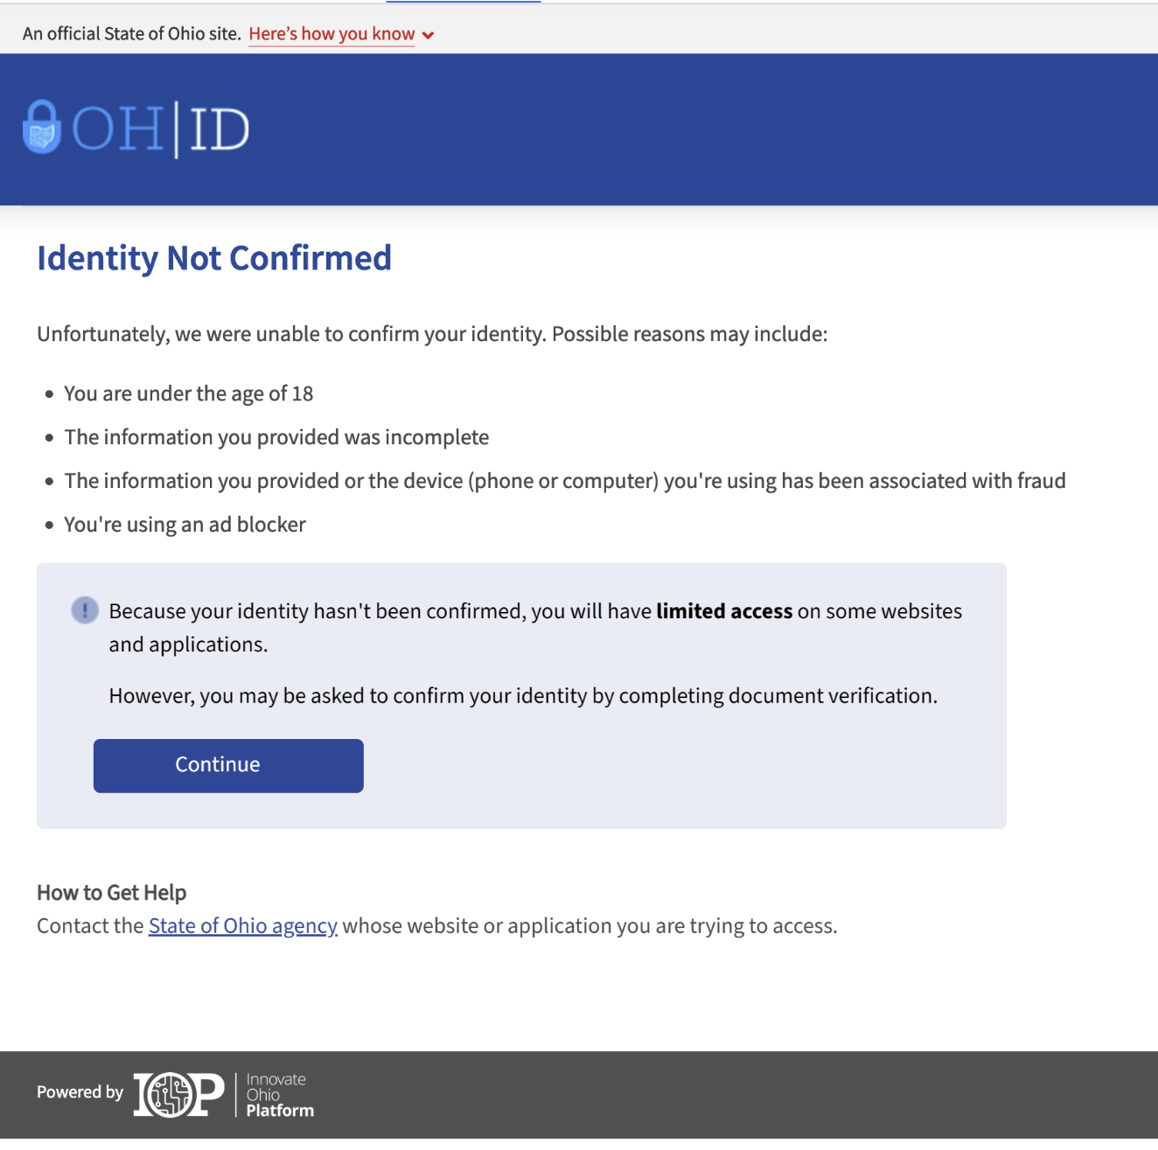
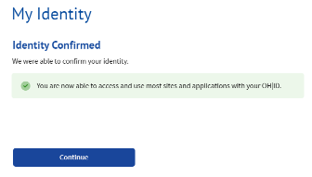
User Journey 1: Existing OHID User, Existing Adoption Grant User: ID Proofing with DocV
7
7. User will verify their information
User will be prompted to verify their information and then will click “Submit”
Please note that if a User does not enter a “Mobile Number” then it will make it less likely that their identity will be confirmed
8
8. The user will be presented a screen to notify them of their ID Proofing evaluation
If the user fails ID Proofing, they will have the option to visit a local office to complete Identity verification in-person. Please see a list of office locations here: Local Agencies Directory | Job and Family Services
Regardless of the user’s ID Proofing score, they will be able to click “Continue” and move forward to DocV

Slide 15
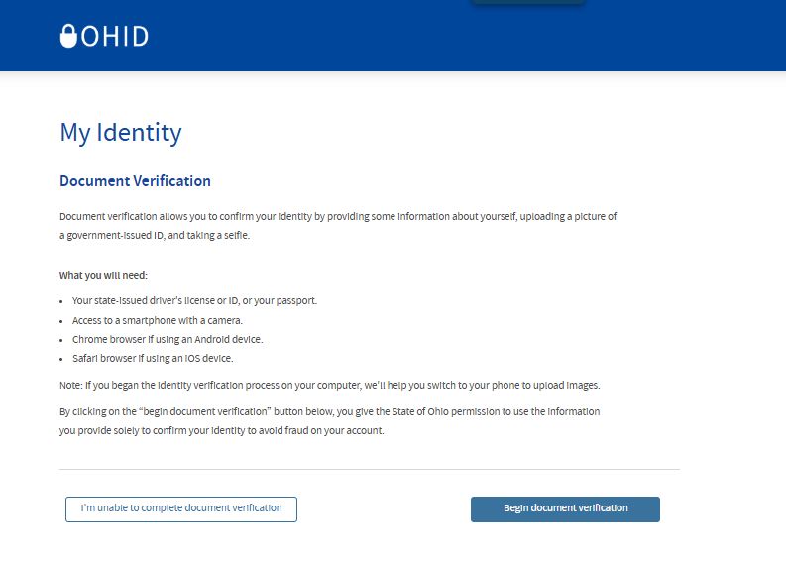
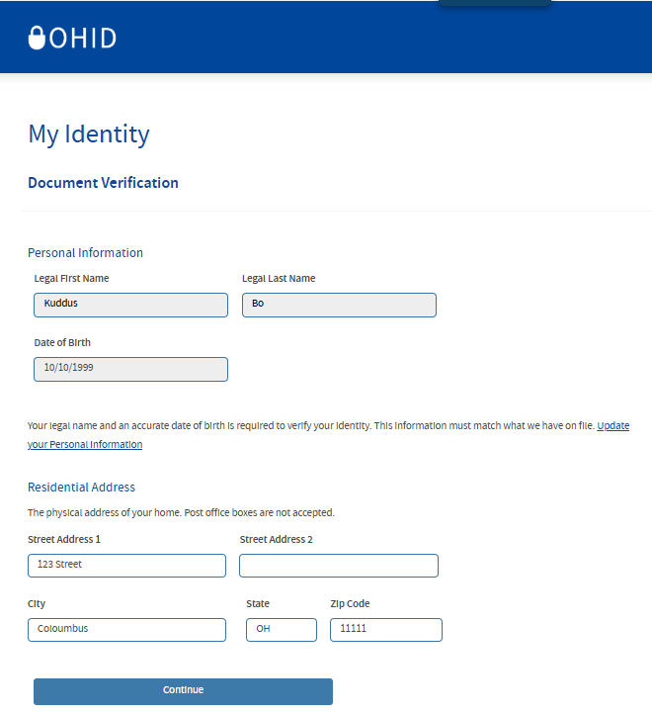
User Journey 1: Existing OHID User, Existing Adoption Grant User: ID Proofing with DocV
9
9. A screen will pop up prompting the user to complete document verification
User will select “Begin document verification”
10
10. The user will be prompted to fill out information and select “Continue”
User will fill out the prompted information and select “Continue”

Slide 16
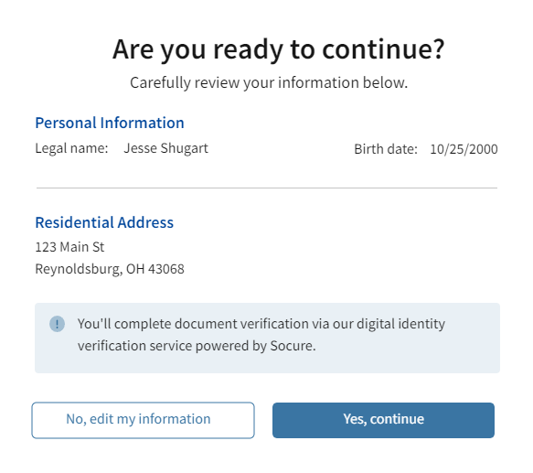
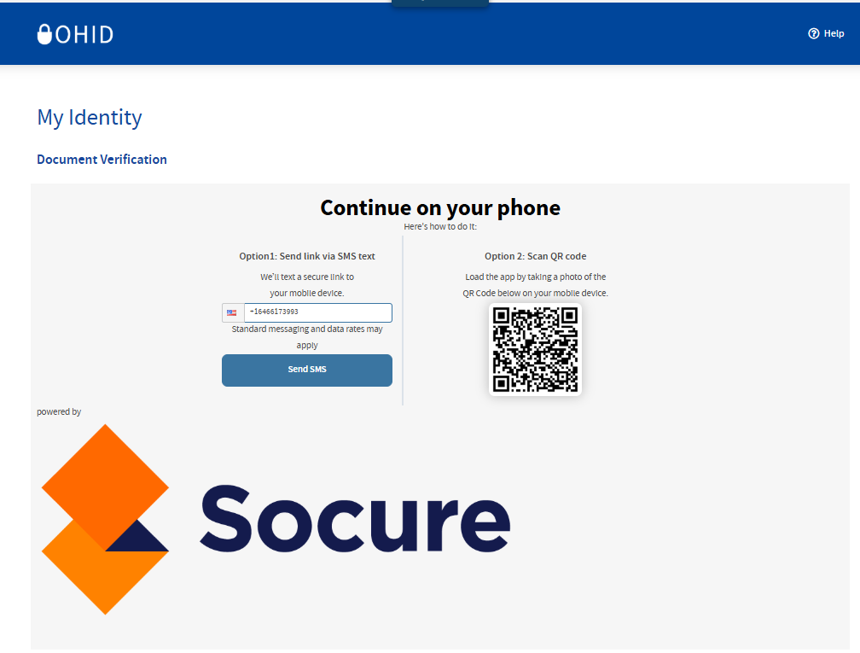
User Journey 1: Existing OHID User, Existing Adoption Grant User: ID Proofing with DocV
11
11. The user will be prompted to confirm that their information is correct
The user will confirm that their information is correct. Once confirmed, the user will select “Yes, continue”
12
12. The user will be presented a screen to access DocV via QR code or SMS code to Phone
The user will scan the QR code via mobile device & will be taken to DocV

Slide 17
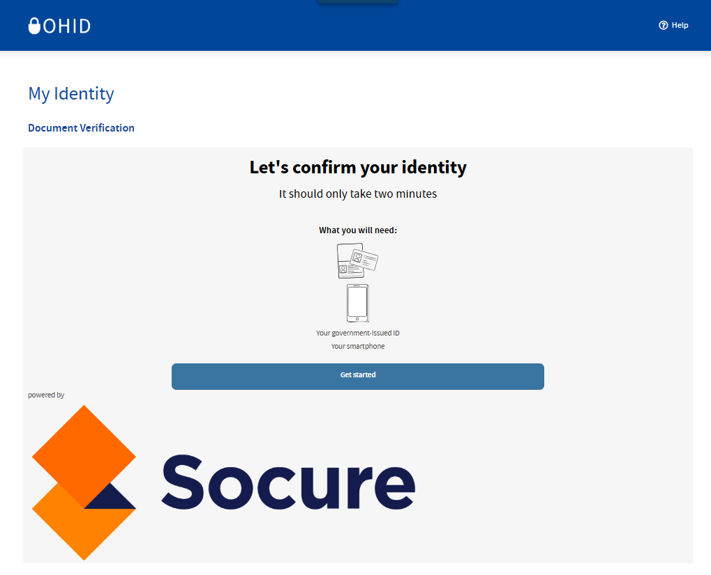
User Journey 1: Existing OHID User, Existing Adoption Grant User: ID Proofing with DocV
13
13. The user will access the DocV application
The user will select “Get started” and proceed with the directions to access the DocV application. Users will need a mobile phone or a tablet with a camera

Slide 18
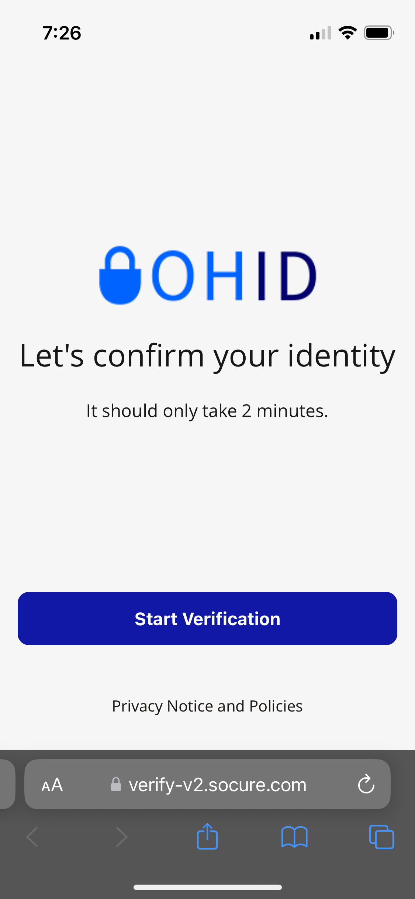
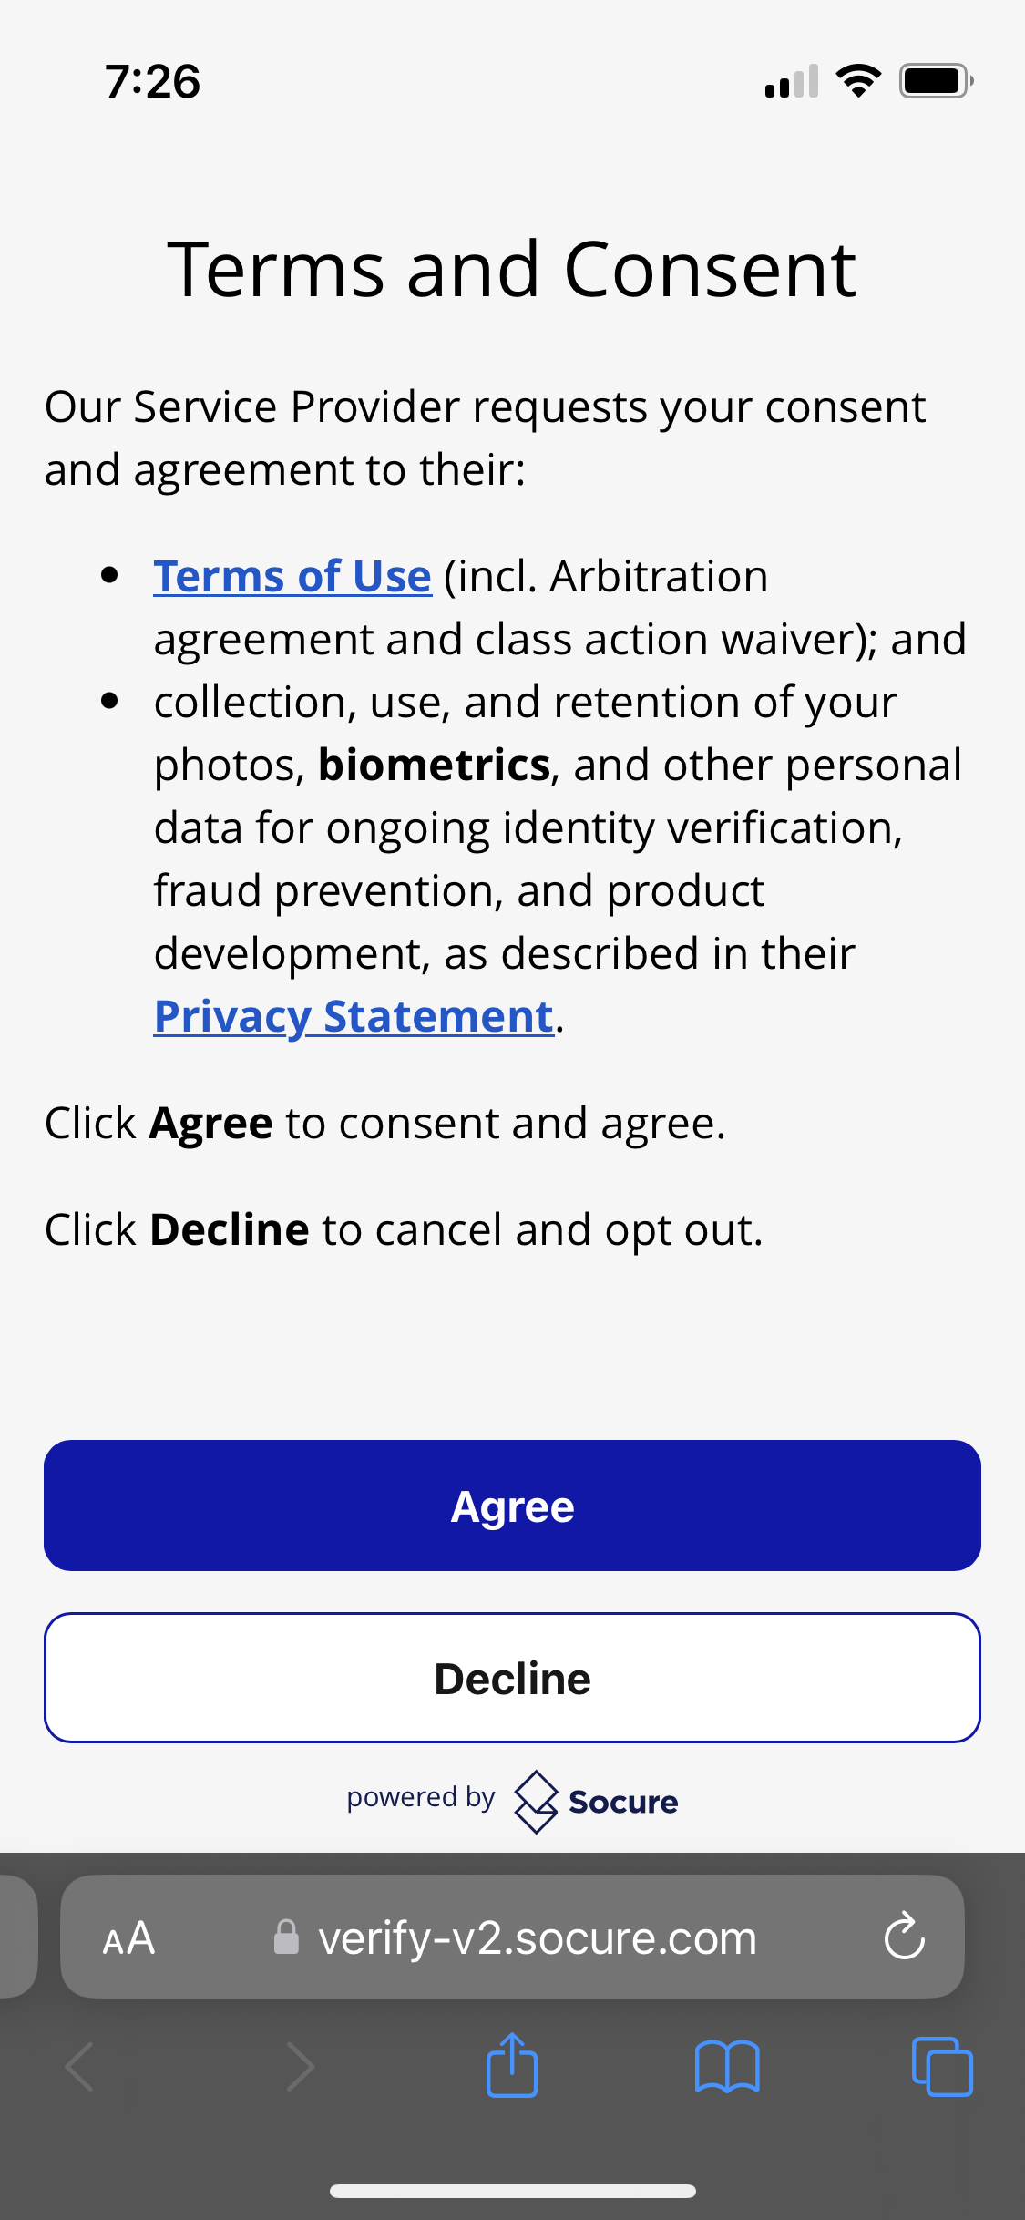
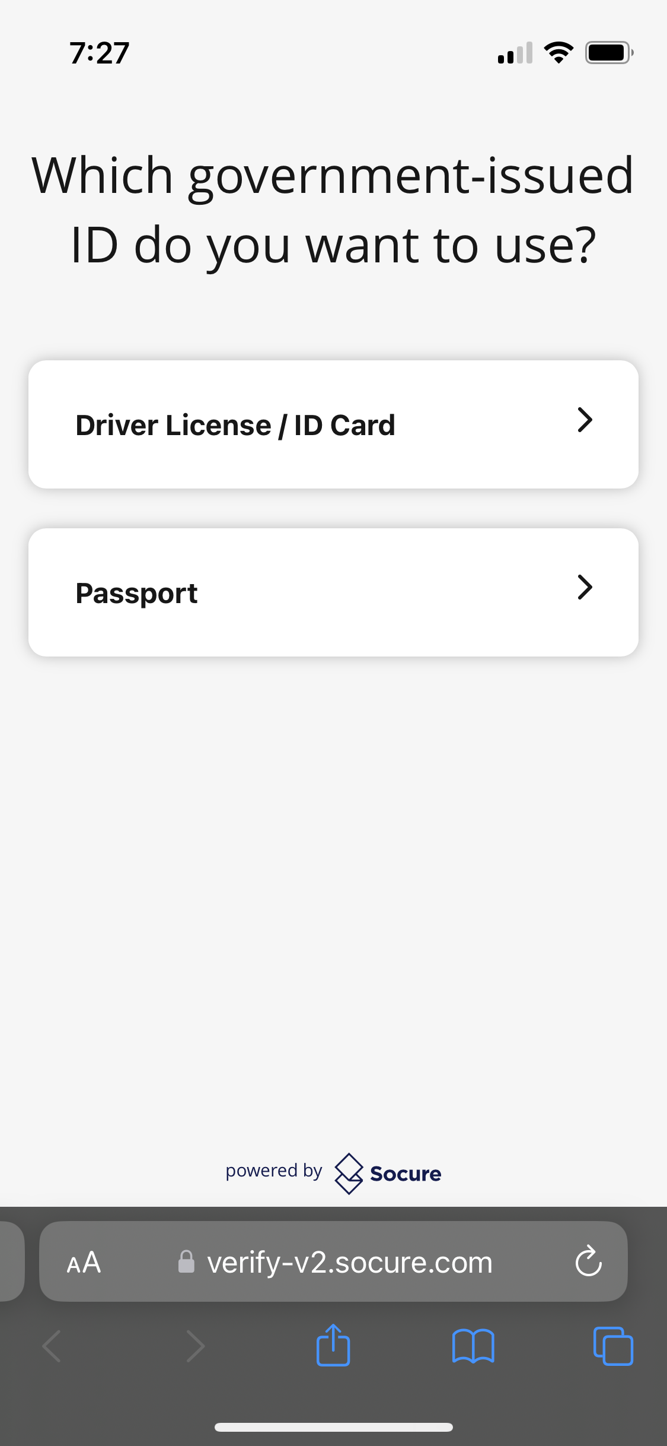
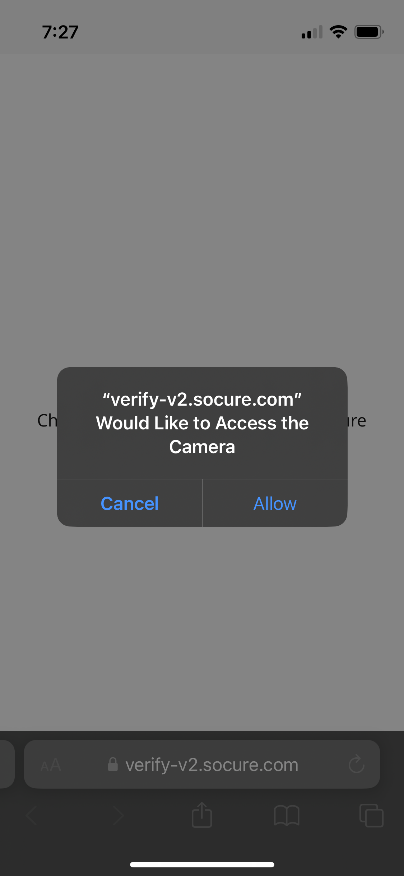
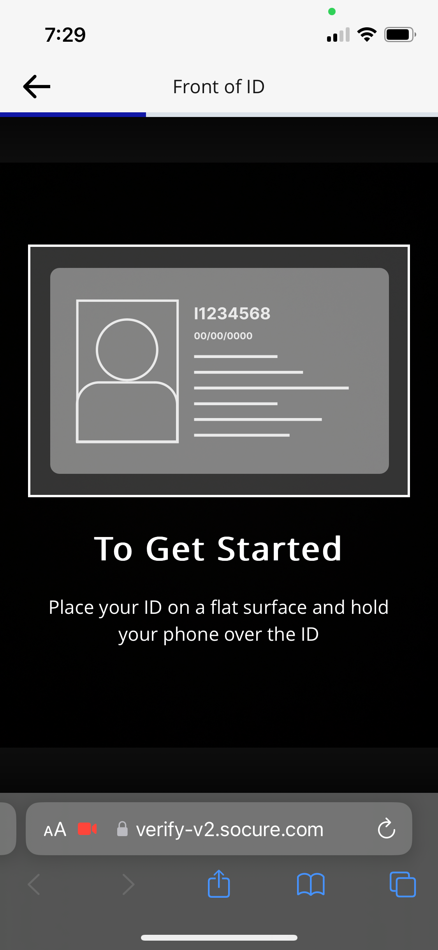
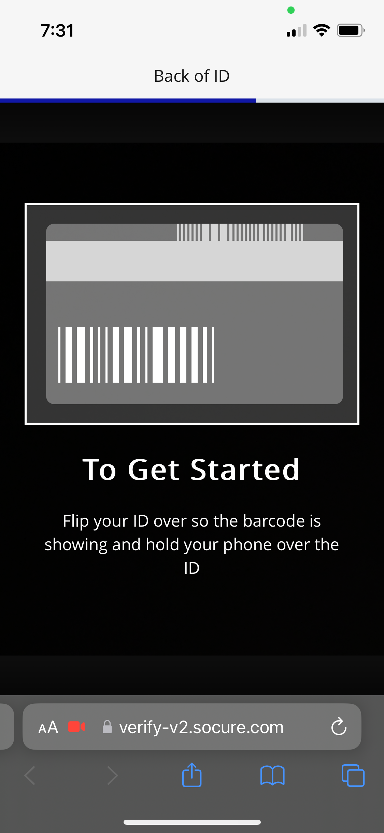
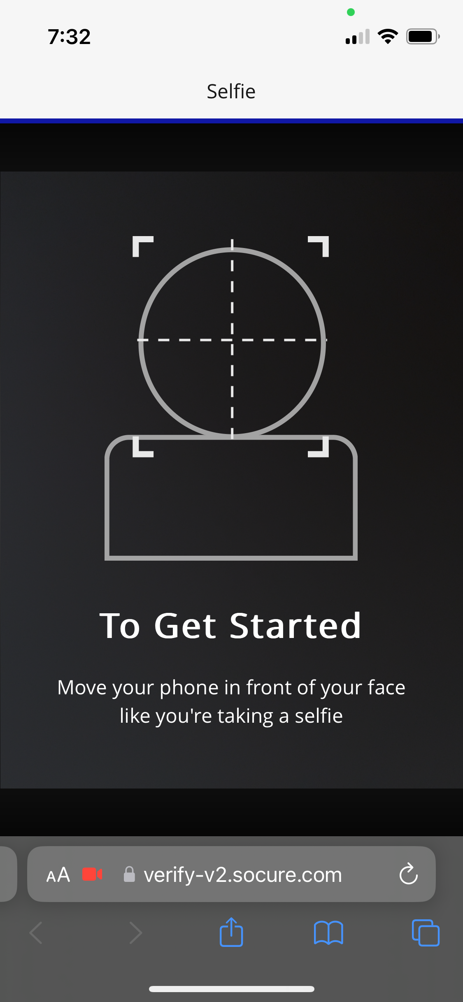
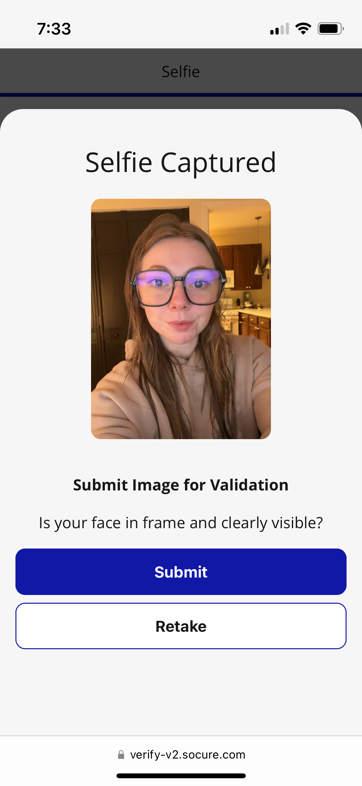
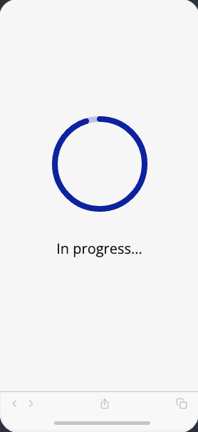
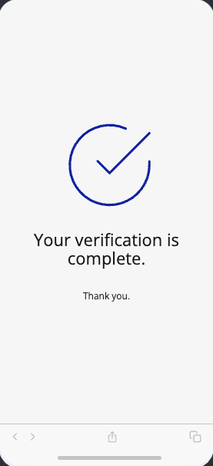
User Journey 1: Existing OHID User, Existing Adoption Grant User: ID Proofing with DocV
14
14. User uploads front and back of their ID and uploads a real-time photo of themselves
For additional guidance, please refer to the supplemental guide titled "Adoption Grant MFA & Socure Enhancements Supplemental Guide"
14

Slide 19
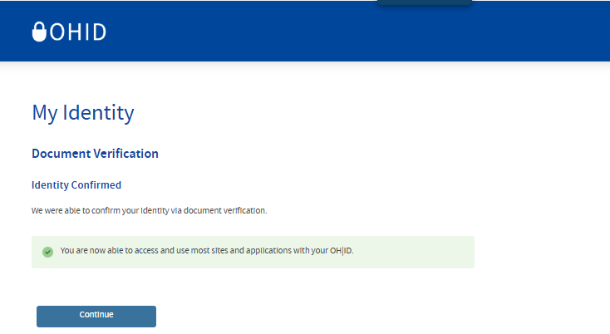
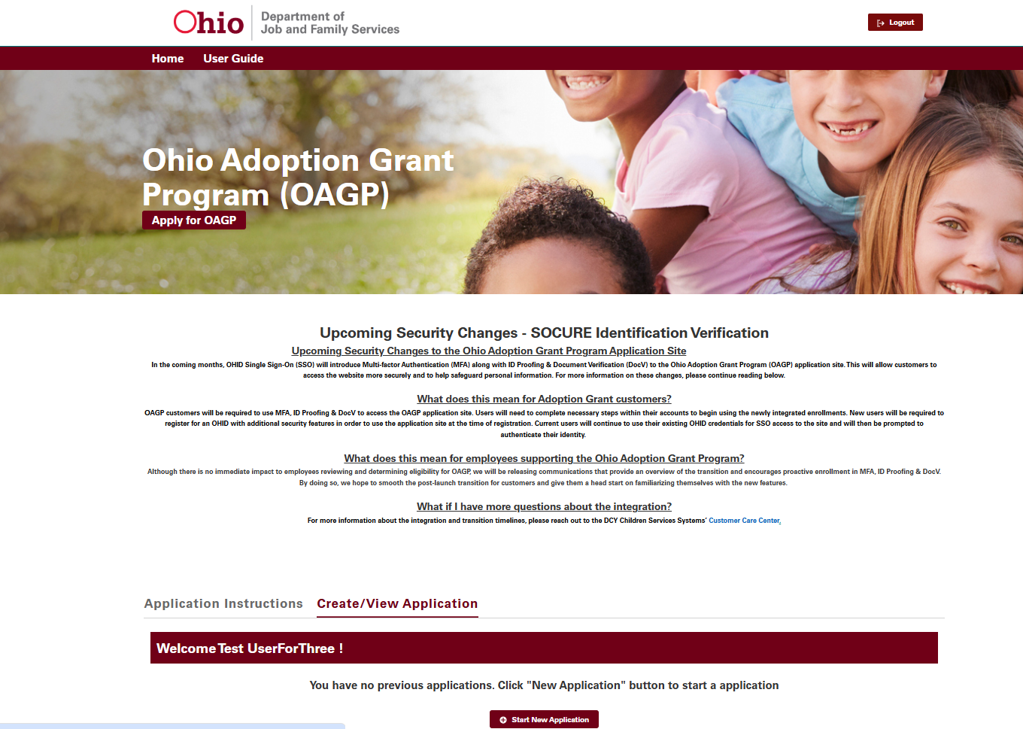
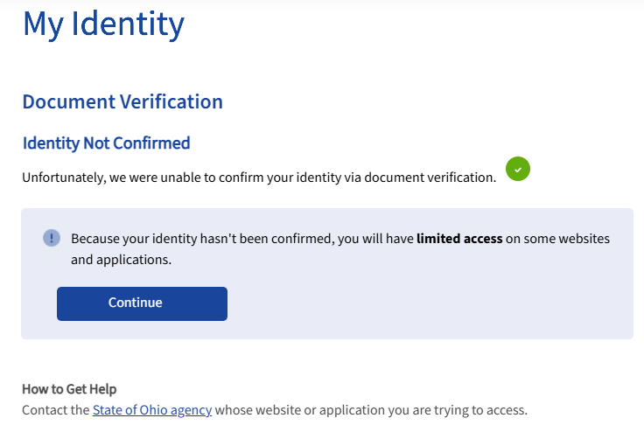
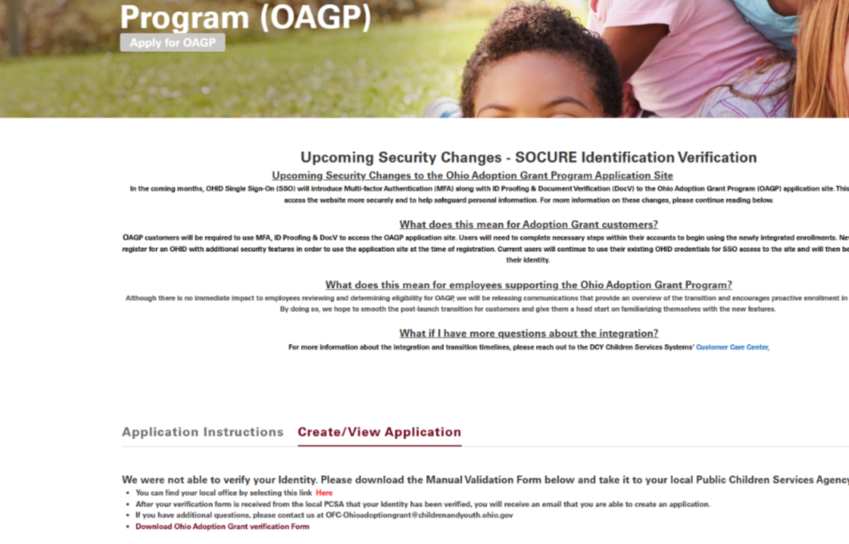


User Journey 1: Existing OHID User, Existing Adoption Grant User: ID Proofing with DocV
15a
15a. If the user passes ID Proofing and DocV, they will be able to log into their account with full access
15b. If the user does not pass either ID Proofing or DocV, the user must visit a local office for review
Please see a list of office locations here: Local Agencies Directory | Job and Family Services
15b
16b1. If the user passes the local office review, they will be able to log into their Adoption Grant account
16b2. If the user does not pass the local office review, they will not be granted access and they will not be able to log into their Adoption Grant account
16b1
16b2

Slide 20
User Journey 2
User Journey 2: Existing OHID User, New Adoption Grant User: ID Proofing with DocV
Notes:
Each section should have a transition slide

Slide 21

User Journey 2: Existing OHID User, New Adoption Grant User: ID Proofing with DocV
KEY
Adoption Actions
OHID Actions
System Actions
Socure Actions
Redirect
System Access Checkpoint
User
User
System
User
User
Begins process on DCY-Adoption Grant application landing page
User clicks “Launch- Apply for the Ohio Adoption Grant”
Redirects to OHID to login
Logs into OHID Account
User completes MFA registration (if not previously completed) or completes MFA through previously selected option
Pass/Fail/Refer
User
User
System
User
Socure Check
System prompts ID Proofing
User submits Personal/Residential Address Information
User presented with ask for Confirm F/L Name, email address and provide physical address again
Presented screen to access DocV via QR code or SMS code to Phone
User
User
User
ID Proofing: Pass
DocV: Pass
DocV
Socure Check
User
Scans QR code via mobile device & taken to DocV
Uploads front and back of their ID and uploads a `real-time photo of themselves
Reads ID barcode and facial recognition
User Starts Adoption Grant Application
Any combination of pass/fail or fail/fail between ID Proofing and DocV
User
Reviewer
User passes review
User
User Starts Adoption Grant Application
Adjudication flag updated in application with result
Must visit a local office for review
Local Office Check
User
Does not pass review
Pass/Fail
Is not granted access to Adoption Grant site

Slide 22
User Journey 2: Existing OHID User, New Adoption Grant User: ID Proofing with DocV
1
User navigates to the Adoption Grant Application Website:
Navigate to Adoption Grant Application Website at the following URL: Ohio Adoption Grant Program | Foster Care and Adoption in Ohio
Select Launch to Apply for the Ohio Adoption Grant
2
2. User clicks “Launch- Apply for the Ohio Adoption Grant”

Slide 23
User Journey 2: Existing OHID User, New Adoption Grant User: ID Proofing with DocV
3
3. User gets redirected to the OHID login page and logs in with their OHID and password
https://ohid.ohio.gov/wps/portal/gov/ohid/login
4
4. User is prompted to complete MFA registration (if not previously completed) or completes MFA through previously selected option
For additional guidance, please refer to the supplemental guide titled "Adoption Grant MFA & Socure Enhancements Supplemental Guide"

Slide 24
User Journey 2: Existing OHID User, New Adoption Grant User: ID Proofing with DocV
5
5. The user will begin the Identity Proofing process
User will be prompted to Identity Proof and will select “Begin Identity Confirmation”
6
6. The user will fill out required Identity information
The user will fill in their personal information, residential address, and mobile phone verification (optional). The user will then select “Submit”

Slide 25
User Journey 2: Existing OHID User, New Adoption Grant User: ID Proofing with DocV
7
7. User will verify their information
User will be prompted to verify their information and then will click “Submit”
Please note that if a User does not enter a “Mobile Number” then it will make it less likely that their identity will be confirmed
8
8. The user will be presented a screen to notify them of their ID Proofing evaluation
If the user fails ID Proofing, they will have the option to visit a local office to complete Identity verification in-person. Please see a list of office locations here: Local Agencies Directory | Job and Family Services
Regardless of the user’s ID Proofing score, they will be able to click “Continue” and move forward to DocV

Slide 26
User Journey 2: Existing OHID User, New Adoption Grant User: ID Proofing with DocV
9
9. A screen will pop up prompting the user to complete document verification
User will select “Begin document verification”
10
10. The user will be prompted to fill out information and select “Continue”
User will fill out the prompted information and select “Continue”

Slide 27
User Journey 2: Existing OHID User, New Adoption Grant User: ID Proofing with DocV
11
11. The user will be prompted to confirm that their information is correct
The user will confirm that their information is correct. Once confirmed, the user will select “Yes, continue”
12
12. The user will be presented a screen to access DocV via QR code or SMS code to Phone
The user will scan the QR code via mobile device & will be taken to DocV

Slide 28
User Journey 2: Existing OHID User, New Adoption Grant User: ID Proofing with DocV
13
13. The user will access the DocV application
The user will select “Get started” and proceed with the directions to access the DocV application. Users will need a mobile phone or a tablet with a camera

Slide 29
User Journey 2: Existing OHID User, New Adoption Grant User: ID Proofing with DocV
14
14. User uploads front and back of their ID and uploads a real-time photo of themselves
For additional guidance, please refer to the supplemental guide titled "Adoption Grant MFA & Socure Enhancements Supplemental Guide"
14

Slide 30
User Journey 2: Existing OHID User, New Adoption Grant User: ID Proofing with DocV
15a
15a. If the user passes ID Proofing and DocV, they will be able to start their Adoption Grant Application
15b. If the user does not pass either ID Proofing or DocV, the user must visit a local office for review
Please see a list of office locations here: Local Agencies Directory | Job and Family Services
15b
16b1. If the user passes the local office review, they will be able to start their Adoption Grant Application
16b2. If the user does not pass the local office review, they will not be granted access and they will not be able to start their Adoption Grant Application
16b1
16b2

Slide 31
User Journey 3
User Journey 3: New OHID User, New Adoption Grant User: ID Proofing with DocV
Notes:
Each section should have a transition slide

Slide 32



User Journey 3: New OHID User, New Adoption Grant User: ID Proofing with DocV
KEY
Adoption Actions
OHID Actions
System Actions
Socure Actions
Redirect
System Access Checkpoint
Email Communication
Redirect
User
User
System
User
System
Begins process on the DCY Adoption application landing page
User clicks “Launch- Apply for the Ohio Adoption Grant”
Redirects to OHID Account Creation
Begins account creation with email verification
Communicates confirmation of User Email
User
User
System
User
Socure Check
Pass/Fail/Refer
Completes OHID account creation and logs into OHID account
User completes MFA
System Prompts ID Proofing
User submits Personal/Residential Address Information
User
User
User
User
User
User presented with ask for Confirm F/L Name, email address and provide physical address again
Presented screen to access DocV via QR code or SMS code to Phone
Scans QR code via mobile device & taken to DocV
Uploads front and back of their ID and uploads a real-time photo of themselves
Reads ID barcode and facial recognition
User passes review
ID Proofing: Pass
DocV: Pass
User
Reviewer
DocV Socure Check
User Starts Adoption Grant Application
Adjudication flag updated in application with result
Any combination of pass/fail or fail/fail between ID Proofing and DocV
User
Reviewer
User passes review
User Starts Adoption Grant Application
Adjudication flag updated in application with result
User
Local Office Check
32
Must visit a local office for review
User
Pass/Fail
Is not granted access to Adoption Grant site
Does not pass review

Slide 33
User Journey 3: New OHID User, New Adoption Grant User: ID Proofing with DocV
1
User navigates to the Adoption Grant Application Website:
Navigate to Adoption Grant Application Website at the following URL: Ohio Adoption Grant Program | Foster Care and Adoption in Ohio
Select Launch to Apply for the Ohio Adoption Grant
2
2. User clicks “Launch- Apply for the Ohio Adoption Grant”

Slide 34
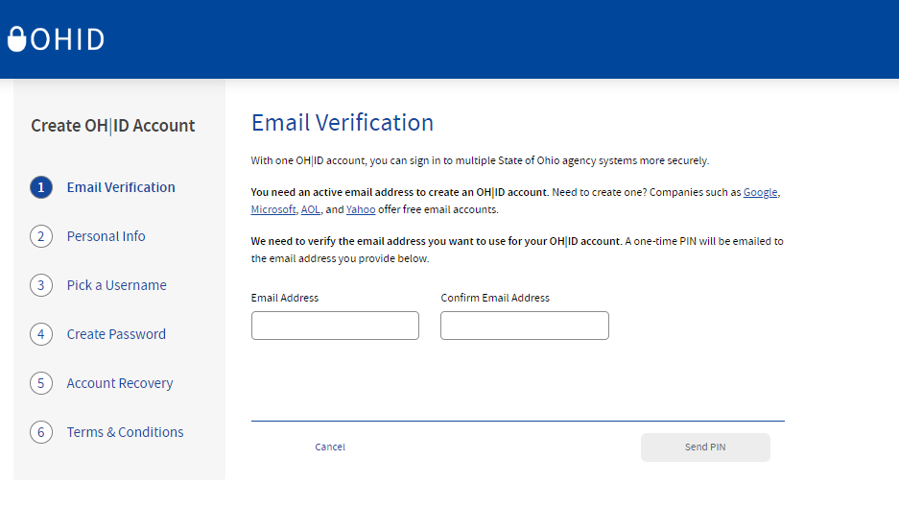
User Journey 3: New OHID User, New Adoption Grant User: ID Proofing with DocV
3
3. User gets redirected to the OHID login page where they can select “Create Account” to begin the OHID account creation process
https://ohid.ohio.gov/wps/portal/gov/ohid/login
4
4. The user will enter an active email address to continue creating an account and select “Send Pin”

Slide 35
User Journey 3: New OHID User, New Adoption Grant User: ID Proofing with DocV
5
5. After the user enters an email address, a PIN will be sent to that email address. The user will need to enter the PIN provided on the email verification screen and select “Verify”
Note: If you do not receive the PIN immediately, request a new PIN using the “Send a new PIN” link
6. The user will then enter a Legal First Name, Last Name, and Date of Birth in MM/DD/YYYY format to continue
Note: Last 4 of SSN is an optional field
6

Slide 36
User Journey 3: New OHID User, New Adoption Grant User: ID Proofing with DocV
7
7. The user will create a username and password for the OHID account
Note: The username must be between 6-64 characters, cannot start or end with a special character, cannot contain only numbers, and may only contain . _ -or @ as special characters
Note: Passwords must be at least 12 characters long; must contain at least one upper case letter, lower case letter, number, and special character; and cannot contain the user’s first name, last name, username, or OHID. You cannot reuse previous passwords. Your new password will expire in 400 days
7
8
8. The user will enter an active cell phone number to enable optional account recovery. Select “Send PIN” to send a PIN to the cell phone number. Enter the PIN to verify your cell phone. (This step is optional)
8

Slide 37
User Journey 3: New OHID User, New Adoption Grant User: ID Proofing with DocV
9
9. User checks the “I Agree” box under the Terms & Conditions section and answers the “Confirm you are not a robot” question
Next, the user selects “Verify,” and then “Create Account”
10. The user will verify receipt of the account creation email, then navigate back to the “Check your Email” page and select the “log in to OHID” hyperlink
Note: Customers can also go directly to https://ohid.ohio.gov/wps/portal/gov/ohid/login and log in on the OHID login page
10

Slide 38
User Journey 3: New OHID User, New Adoption Grant User: ID Proofing with DocV
11
11
11. The user will login to OHID with their OHID and password
12
12. User is prompted to complete MFA registration. They will need to enroll in two different methods
For additional guidance, please refer to the supplemental guide titled "Adoption Grant MFA & Socure Enhancements Supplemental Guide"

Slide 39
User Journey 3: New OHID User, New Adoption Grant User: ID Proofing with DocV
13
13. The user will begin the Identity Proofing process
User will be prompted to Identity Proof and will select “Begin Identity Confirmation”
14
14. The user will fill out required Identity information
The user will fill in their personal information, residential address, and mobile phone verification (optional). The user will then select “Submit”

Slide 40
User Journey 3: New OHID User, New Adoption Grant User: ID Proofing with DocV
15
15. User will verify their information
User will be prompted to verify their information and then will click “Submit”
Please note that if a User does not enter a “Mobile Number” then it will make it less likely that their identity will be confirmed
16
16. The user will be presented a screen to notify them of their ID Proofing evaluation
If the user fails ID Proofing, they will have the option to visit a local office to complete Identity verification in-person. Please see a list of office locations here: Local Agencies Directory | Job and Family Services
Regardless of the user’s ID Proofing score, they will be able to click “Continue” and move forward to DocV

Slide 41
User Journey 3: New OHID User, New Adoption Grant User: ID Proofing with DocV
17
17. A screen will pop up prompting the user to complete document verification
User will select “Begin document verification”
18
18. The user will be prompted to fill out information and select “Continue”
User will fill out the prompted information and select “Continue”

Slide 42
User Journey 3: New OHID User, New Adoption Grant User: ID Proofing with DocV
19
19. The user will be prompted to confirm that their information is correct
The user will confirm that their information is correct. Once confirmed, the user will select “Yes, continue”
20
20. The user will be presented a screen to access DocV via QR code or SMS code to Phone
The user will scan the QR code via mobile device & will be taken to DocV

Slide 43
User Journey 3: New OHID User, New Adoption Grant User: ID Proofing with DocV
21
21. The user will access the DocV application
The user will select “Get started” and proceed with the directions to access the DocV application. Users will need a mobile phone or a tablet with a camera

Slide 44
User Journey 3: New OHID User, New Adoption Grant User: ID Proofing with DocV
22
22. User uploads front and back of their ID and uploads a real-time photo of themselves
For additional guidance, please refer to the supplemental guide titled "Adoption Grant MFA & Socure Enhancements Supplemental Guide"
22

Slide 45
User Journey 3: New OHID User, New Adoption Grant User: ID Proofing with DocV
23a
23a. If the user passes ID Proofing and DocV, they will be able to start their Adoption Grant Application
23b. If the user does not pass either ID Proofing or DocV, the user must visit a local office for review
Please see a list of office locations here: Local Agencies Directory | Job and Family Services
23b
24b1. If the user passes the local office review, they will be able to start their Adoption Grant Application
24b2. If the user does not pass the local office review, they will not be granted access and they will not be able to start their Adoption Grant Application
24b1
24b2

Slide 46
User Journey 4
User Journey 4: Adoption Grant and OHID - Profile Updates
Notes:
Each section should have a transition slide

Slide 47
User Journey 4: Adoption Grant and OHID - Profile Updates
KEY
Adoption Actions
OHID Actions
System Actions
Redirect
System Access Checkpoint
Redirect
User
User
System
User
System
User Logs into their OHID account
User selects Account Settings to update their profile information and saves the changes
System sends new token to Adoption Grant to re-prompt ID Proofing
Logs into their Adoption Grant account
System Prompts ID Proofing
User
Pass/Fail/Refer
User
User
Socure Check
User presented with ask for Confirm F/L Name, email address and provide physical address again
User submits Personal/Residential Address Information
Presented screen to access DocV via QR code or SMS code to Phone
ID Proofing: Pass
DocV: Pass
User
User
User
DocV Socure Check
Application
Scans QR code via mobile device & taken to DocV
Uploads front and back of their ID and uploads a real-time photo of themselves
Reads ID barcode and facial recognition
User Profile information is Updated
Any combination of pass/fail or fail/fail between ID Proofing and DocV
User
Reviewer
User passes review
User
User logs into Adoption Grant. User profile update is complete.
Adjudication flag updated in application with result
Must visit a local office for review
Local Office Check
User
Does not pass review
Pass/Fail
Is not granted access to Adoption Grant site

Slide 48
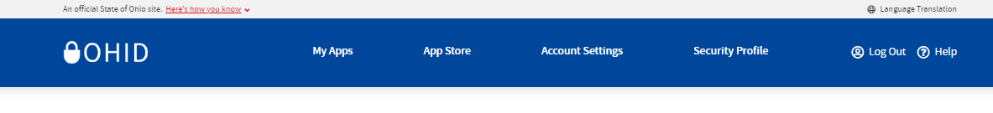
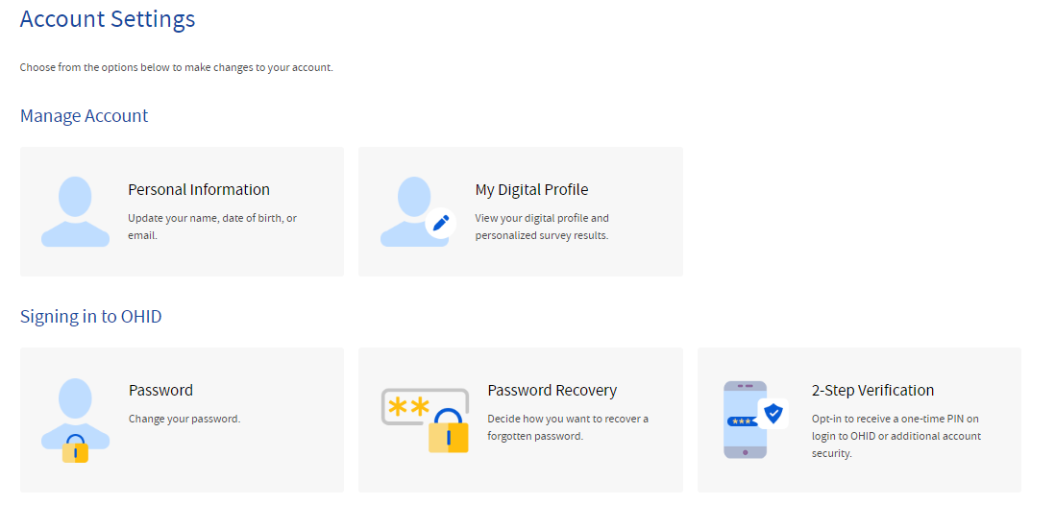
User Journey 4: Adoption Grant and OHID - Profile Updates
1
1. User logs into their OHID account with their OHID and password
https://ohid.ohio.gov/wps/portal/gov/ohid/login
2
2. User clicks Account Settings to update their profile information and saves the changes in OHID
3. The next time the user logs into Adoption Grant, they will be prompted to complete ID Proofing/DocV again
Please refer to User Journey 1 and complete all of the steps beginning at step 5 to successfully update your profile

Slide 49
Frequently Asked Questions
Notes:
Each section should have a transition slide

Slide 50
MFA FAQs
Question: ​My Multifactor Authentication (MFA) failed. Why did this happen?
Answer: Your MFA can fail for various reasons such as putting an incorrect or expired PIN, waiting too long to approve a push notification, or accidently selecting decline on the push notification. If the MFA method you have chosen failed, please try your preferred option again, or use a secondary method. Each MFA enrollment option (SMS message, phone call, email, etc.) expires after 5 minutes.
Question: Do I need any additional apps to log into the Adoption Grant Application Website?
Answer: You can use the IBM Verify App, a different authentication app, or Fido Device to complete MFA. However, you will still have the option for SMS, Phone Call, and Email to complete MFA, so you do not need any additional applications.
1
2
Question: I have added text and phone call as my MFA options, why does the system tell me I still need a second method?
Answer: For text message and phone call to count as separate forms of MFA, you must use a different phone number for each method. If you do not have two numbers, you will need to enroll in either Email or IBM Verify as your secondary MFA option.
Question: I am using Email for MFA and have not received a code, what do I do?
Answer: Check your spam folder if you are not receiving the passcode directly to your inbox. If this does not work, attempt to use a secondary MFA option.
3
4

Slide 51
MFA FAQs
Question: ​If I use the automated telephone option, what number shows on the caller ID, and what steps do I complete to authenticate successfully?
Answer: The number may look different for each user, but users can add the number to their contacts. Customers will receive a phone call and will be provided a PIN over the phone. After answering the call, customers will enter the PIN provided by the automated voice to authenticate and log in successfully. If the call is not answered, a voicemail will be left with the verification code. The code will remain valid for 5 minutes after the call.
6
Question: I have an iPhone, and when I receive a telephone call from an unknown number, it does a silent ring, and if I select answer, the iPhone rings the number back; if customers do this, what would be the result.
Answer: ​If you miss the call or the call is silenced, the automated phone call will leave a voicemail with the PIN. Please be mindful of the time limit for confirmation and complete your MFA authentication as quickly as possible.
5
7
Question: If a customer sets up more than 2 MFA options, how can they verify during this process?
Answer: ​The system will only trigger the option that they select to use when verifying, but all their set up enrollment options will be available to them to choose from.
8
Question: Will the phone verification options work with a Google phone number?
Answer: ​As long as the number can receive SMS or phone calls, there’s nothing to prevent it from being used for MFA.

Slide 52
MFA FAQs
Question: ​Can a single phone number be used by more than one person? For example, a citizen who may not own their own phone (e.g. shelters where multiple people may share a phone).
Answer: There’s nothing to prevent that. However, if a text or phone call is sent to that phone, and the user doesn’t have it in their possession, they will not be able to access to the application. Furthermore, the loss of that method will render 2 accounts unusable.
Question: If the customer is not able to use their verification code after five minutes, is there a limit on the number of times they can request a verification code before they are locked out from OHID creation?
Answer: ​There is not currently a limit on the number of times a customer requests a verification code when setting up MFA methods.
9
10
11
Question: Why am I receiving this error “404 Page not found”?
Answer: The “404 Page not found” error typically means the user doesn’t have proper access or there may be an issue with caching. This could also be a result of the occurrence of data mismatch between the agency and IOP.
12
Question: Why am I not receiving a phone call on my phone when trying to enroll in the Phone Call MFA option?
Answer: ​Phone carriers have scam blocking apps that may interfere with the delivery of MFA calls. Any sort of SPAM/RoboCall blocking software should be disabled when troubleshooting this issue. You may also check your carrier's application settings for additional options to adjust allowed calls.

Slide 53
ID Proofing/DocV FAQs
Question: Where is my data going?
Answer: OHID & Socure have detailed privacy statements. For interested parties, please refer to the OHID Privacy Statement and Socure’s Privacy Statement to learn more about the collection and use of personal information.
Question: Why am I not passing ID Proofing?
Answer: ID Proofing is a process based on identifying potentially suspicious account indicators. Sometimes this information provided does not match sourced information. During ID Proofing, there are 3 areas that can be triggered as a result: Pass, Absolute Fail, Refer. Please double check they are entering their personal information correctly and confirm the following:
Are they logging in from a new device? Are they logging in from a new location? Have they created a new email address or phone number?
1
2
3
Question: What if my facial features are no longer similar to my features in my ID?
Answer: DocV does not take gender into account, so transitioning will not change the outcome unless major cosmetic surgery is performed. If this is the case, the law states you should update your ID.
As far as face tattoos, burns, or scars - These should not be an issue as DocV uses a vector of over 100 numbers that represent the most important features of the face in the image. DocV predicts the likelihood that the two facial images belong to the same person by comparing the distance between the facial embeddings.
4
Question: What if I see this during the DocV process?
“An error has occurred. Try again”
Answer: There may have been a backend processing error. Close the DocV application and try the process again. If you keep getting issues, please reach out to Socure for additional assistance.

Slide 54
ID Proofing/DocV FAQs
5
Question: What if I see this during the DocV process? “This link works on mobile devices and on supported browsers. Please use Chrome browser on Android and Safari on iOS”
Answer: If you are using an Android Device, please ensure you are using a Chrome browser. If you are using an iOS Device, please ensure you are using a Safari browser.
6
Question: What if I see this during the DocV process?
“You have reached the maximum number of resubmit attempts”
Answer: You are only able to attempt DocV 2 times within a 72-hour time- period. Please try the DocV process from the beginning after the 72-hour time- period has passed.
7
Question: What if I see this during the DocV process? ”Your session has expired”
Answer: You may have been in the middle of the session and stepped away for a minute. DocV times out after 60 minutes. Please go back to the original browser to begin the DocV process again.
8
Question: What if I see this screen during the DocV process?
“You hit a problem. Our team is working on it”
Answer: There may have been a backend processing error. Close the DocV application and try the process again. If you keep getting issues, please reach out to Socure for additional assistance.

Slide 55
ID Proofing/DocV FAQs
Question: What if I see this screen during the DocV process?
“Current browser cannot analyze the video stream. Please use Chrome browser on Android or Safari on iOS”
Answer: The browser you are using is not supported. If you are using an Android Device, please ensure you are using a Chrome browser. If you are using an iOS Device, please ensure you are using a Safari browser.
Question: What if I see this screen during the DocV process?
“Communication with server failed. Please check your network connection”
Answer: Your internet connection may be weak. Troubleshoot and ensure you are connected to Wi-Fi. If you are able to use data, try taking yourself off your Wi-Fi connection if you are not able to get a stronger signal.
9
10
Question: How are ID Proofing scores determined?
Answer: During the ID Proofing process, impact indicators are triggered to evaluate the user's identity. Based on these indicators, one of three ID Proofing scores is assigned: pass, fail, or refer. For purposes of access to the Adoption Grant application, refer and fail will be treated the same.
Question: Can expired licenses or other forms of outdated identification be used for authentication with DocV?
Answer: No, Socure requires valid, non-expired identification to complete DocV successfully.
11
12

Slide 56
ID Proofing/DocV FAQs
Question: Does DocV accept any passports that are not US Passports?
Answer: Yes, Socure's identity verification system can process non-U.S. passports to confirm a user's identity.
Question: Are there any phone model and operating system requirements for DocV?
Answer: To function properly, Socure DocV requires a minimum iOS version of 13 and later or Android OS version of Android 5.1 (SDK Version 22) and later.
13
14

